Slide 1
Parallelize Boids Algorithm
資工所 施益豪
資工所 謝禎原
資工所 盧俊言

Slide 2
Outline
Introduction
Motivation
Proposed solution
Evaluation
Related work
Contribution
Reference

Slide 3

Introduction
Boids - “bird-oid object", which refers to a bird-like object
The Boids simulation was first created by Craig Reynolds in 1986,which simulates the basic flocking motion of animals such as birds.
There are three rules which guide the boids in their trajectories about the screen.

Slide 4
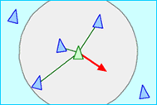
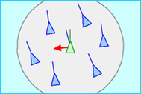
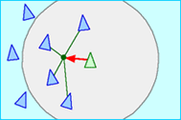
Separation
making sure that no two boids are too close to each other and avoiding collisions with other boids nearby
Alignment
steering boids towards the average direction and speed of surrounding boids
Cohesion
moving towards the center of mass, tending towards the average position of all other boids in a neighboring vicinity

Slide 5
Related Work
A Distributed Behavioral Model[1]
The behavioral model is used to control the boid's flight and flocking that is complicated enough.
Each instance of these objects needs a computational process to apply the behavioral programs to the internal data.
In the literature of parallel and distributed computer systems, flocks and schools are given as examples of robust self-organizing distributed systems

Slide 6
Related Work
Particle Swarm Optimization

Slide 7


Motivation
Animation
Visualization
Notes:
is the most obvious method to see the difference in acceleration through parallel system

Slide 8

Proposed Solution

Slide 9
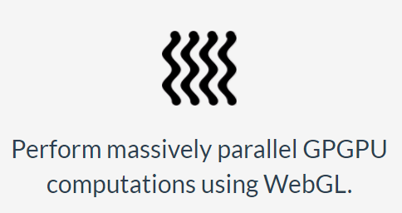
Proposed Solution
GPU.js - a JavaScript Acceleration library for GPGPU (General purpose computing on GPUs)
Automatically compile simple JavaScript functions into shader language and run them on the GPU.

Slide 10

Proposed Solution
GPU.js - a JavaScript Acceleration library for GPGPU (General purpose computing on GPUs)
In case a GPU is not available, the functions will still run in regular JavaScript.

Slide 11
Environment
Hardware
GPU : NVIDIA GeForce GTX 1080
CPU : Intel(R) Xeon(R) CPU E5-1620 v3 * 8
Memory : 8G
Language
JavaScript, HTML
Notes:
serquential frame rate
1024/60
2048/23-25
4096/6
8192/1-2
parallel
1024/60
2048/60
4096/60
8192/46-47
16384/26
32768/12
65536/6
131072/3

Slide 12
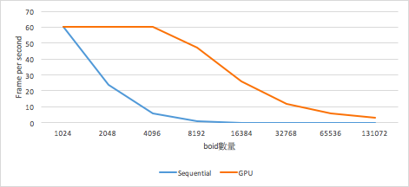
Evaluation
GPU vs Sequential
模式
 | Sequential | GPU
1024 | 60(FPS) | 60
2048 | 24 | 60
4096 | 6 | 60
8192 | 1 | 47
16384 | x | 26
32768 | x | 12
65536 | x | 6
131072 | x | 3
數量
Notes:
serquential frame rate
1024/60
2048/23-25
4096/6
8192/1-2
parallel
1024/60
2048/60
4096/60
8192/46-47
16384/26
32768/12
65536/6
131072/3

Slide 13
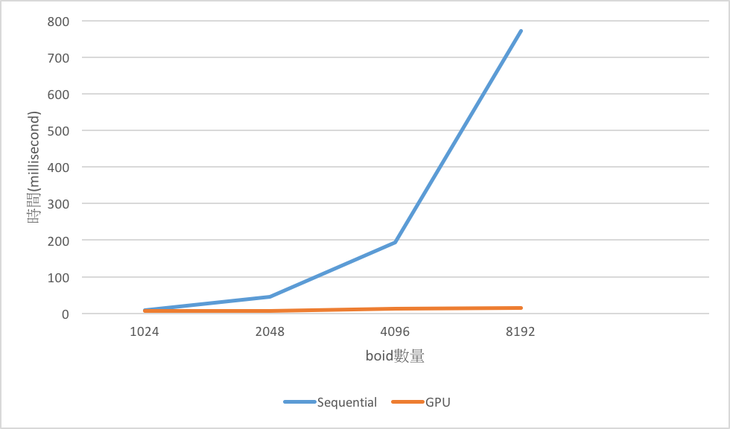
Evaluation
GPU vs Sequential
模式
 | Sequential | GPU
1024 | 8.45(ms) | 6.28
2048 | 44.85 | 7.12
4096 | 193.70 | 11.99
8192 | 771.99 | 15.34
數量
Notes:
serquential frame rate
1024/60
2048/23-25
4096/6
8192/1-2
parallel
1024/60
2048/60
4096/60
8192/46-47
16384/26
32768/12
65536/6
131072/3

Slide 14
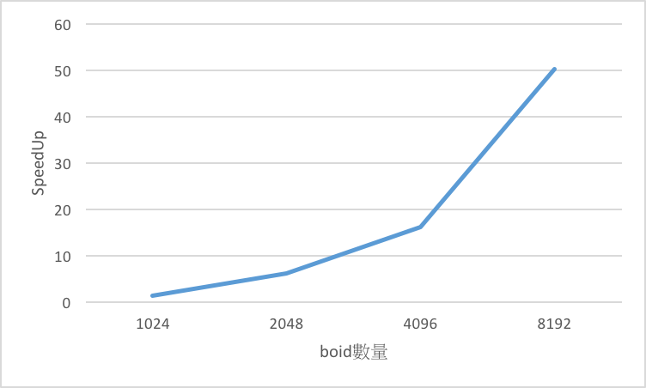
Evaluation
SpeedUp
 | Speedup
1024 | 1.35
2048 | 6.30
4096 | 16.16
8192 | 50.33
數量
Notes:
serquential frame rate
1024/60
2048/23-25
4096/6
8192/1-2
parallel
1024/60
2048/60
4096/60
8192/46-47
16384/26
32768/12
65536/6
131072/3

Slide 15
Contribution

Slide 16
Reference
[1] Reynolds, C. 1987. Flock, Herds, and Schools: A Distributed Behavioral Model. In Proceedings of the 14th Conference on Computer graphics and interactive techniques (SIGGRAPH ‘87), 23-34.
[2] Banks, A. Vincent, J. and Anyakoha, C. 2007. A Review of Particle Swarm Optimization. Part I: Background and Development. In Natural Computing, 467-484.
[3] Bouffanais, R. 2016. Design and Control of Swarm Dynamics
[4] Kennedy, J. Eberhart, R. 1995. Particle Swarm Optimization. In Proceedings of IEEE International Conference on Neural Networks. 1942–1948.

Slide 17
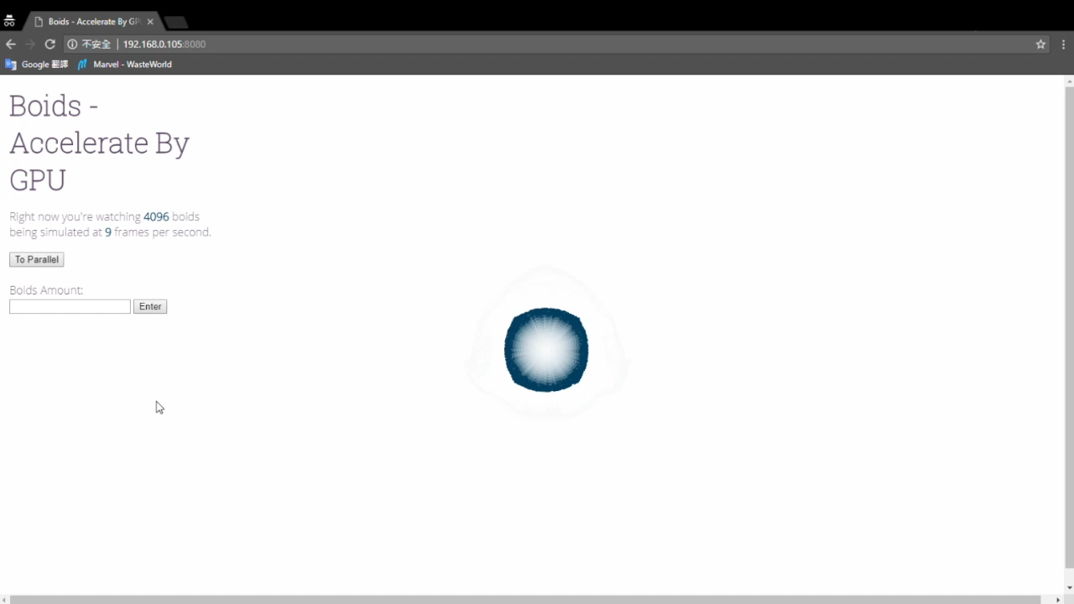

Slide 18
Q & A

Slide 19

Proposed Solution
Parallel.js - a tiny library for multi-core processing in Javascript
Javascript is fast, but lacks the parallel computing capabilities of its peer languages due to its single-threaded computing model.

Slide 20

Proposed Solution
Parallel.js - a tiny library for multi-core processing in Javascript
Parallel.js solves that problem by giving high level access to multi-core processing using web workers. It runs on node and in browser.

